Slide 1


Slide 2
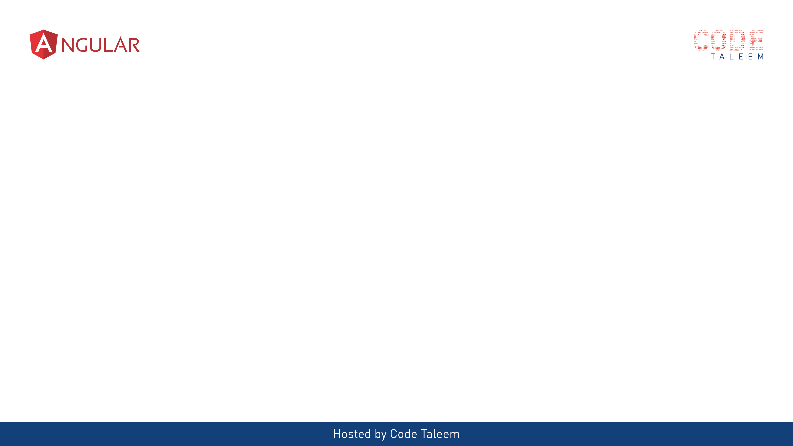
Chapter 1 - Angular Framework
Video contains:-
What is Angular & Why?
Difference between traditional website and SPA
Angular Js vs Angular (9)

Slide 3
What is Angular & Why?
Angular is a JS framework which allow you to create reactive Single Page Application.
Angular is building Mobile and desktop web applications
It written typescript-based open source web application framework led by Angular team at Google.
Better performance

Slide 4
Traditional Application
Single Page Application
Request for Pages
SERVER
Response for Pages
CLIENT
Request for Data
Response for Data
CLIENT
SERVER
Multiple Page requests going to Server.
Every response page getting reloaded
Single request to load the APP. Complete App package in first time response .
Multiple data requests going to Server.
Every response page not reloaded. Content only changed

Slide 5
AngularJs vs Angular (9)
Angular Js - The architecture of AngularJS is based on the model-view-controller (MVC) design. It is first version of Angular – oct-2010
Latest version – Angular 9 . Every six months release the new version.
Angular JS | Angular
MVC Design | Components and Modules
It is written in Javascript | It is written in Typescript
Not build in Mobile support | Mobile Support
$routeprovider.when() to configure routing | uses @RouteConfig{(…)}
Performance AngularJS was originally developed for designers, not developers | Better performance
Angular Js (V1)
Angular (V2)
Angular (V4)
Angular (V9)

Slide 6
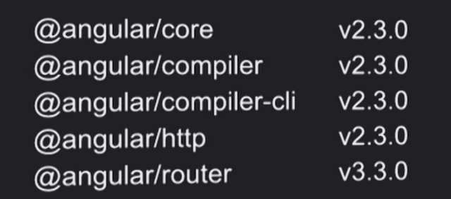
Why skip angular 3 ?
Angular is being developed in a MonoRepo.
@angular/core, @angular/compiler, @angular/router etc are in the same repo and may have their own versions.

Slide 7

Upcoming Video Chapter 2 - Angular 9 Features and Update
Video contains:-
Semantic Versioning
Angular 9 Features
Angular 9 Advantages
How to update current version

Slide 8
Chapter 2 - Angular 9 Features and Update
Video contains:-
Semantic Versioning
Angular 9 Features
Angular 9 Advantages
How to update current version

Slide 9
Semantic Versioning
Major (2.1.0): New Features, Potential breaking changes
Minor (2.1.0): New Features, No breaking changes
Patch (2.1.0): No Features, No breaking changes, Bug fixes
2
1
0
Major
Minor
Patch

Slide 10
Angular 9 Features
Welcome Default Ivy - the Ivy renderer is the default Angular compiler
- "angularCompilerOptions": { "enableIvy": true }
Angular Core Type-Safe Changes - One of the APIs for testing Angular apps is called TestBed
- TestBed.inject(ChangeDetectorRef) // ChangeDetectorRef
ModuleWithProviders Support
- All of your code becomes in sync with the latest changes
- ng update
Changes with Angular Forms
- <ng-form></ng-form>

Slide 11
Angular 9 Features
Dependency Injection Changes in Core
- @Injectable({ providedIn: 'platform' }) class MyService {...}
6. Enhancement of Language Service
7. Service Worker Updates
8. i18n Improvements
9. API Extractor Updates
Angular Component Updates

Slide 12
Angular 9 Advantages
Smaller bundle sizes
Faster testing
Better debugging
Improved CSS class and style binding
Improved type checking
Improved build errors
Improved build times, enabling AOT on by default
Improved Internationalization
New options for 'providedIn‘
IDE & language service improvements

Slide 13
Ivy size Improvements – Total bundle size chart

Slide 14
Updating to Angular Version 9
Updating CLI Apps
For step-by-step instructions on how to update to the latest Angular release, use the interactive update guide at update.angular.io
If your application uses the CLI, you can update to version 9 automatically with the help of the ng update script:
- ng update @angular/core@8 @angular/cli@8
- git add .
- git commit --all -m "build: update Angular packages to latest 8.x version"
- ng update @angular/cli @angular/core --next`

Slide 15
Upcoming Video Chapter 3 – Angular CLI & Project Skeleton
Video Contains:-
Prerequisites
CLI Commands
Project Skeleton Overview

Slide 16
Chapter 3 – Angular CLI & Project Skeleton
Video Contains:-
Prerequisites
CLI Commands
Project Skeleton Overview

Slide 17
Prerequisites
- HTML,
- CSS,
- Javascript,
- Typescript
- Node js ( based on Angular version 9 – node version 10 and above)
- npm install –g @angular/cli
IDE:
- Visual studio Code
Version check:
- node –v, npm –v, ng version

Slide 18
CLI Commands
https://angular.io/cli
ng help
ng generate --help
ng new my-first-project
ng serve
ng build my-app -c production
ng g m moduleName –flat –module=app
ng g m moduleName –routing
ng g c componentName --skipTests=true --inlineStyle=true

Slide 19
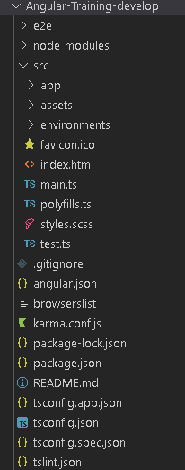
Project Skeleton Overview

Slide 20
Upcoming Video Chapter 4 – Angular Building blocks
Video Contains:-
Building block of Angular
Templates and views

Slide 21
Chapter 4 – Angular Building blocks
Video Contains:-
Building block of Angular
Templates and views

Slide 22
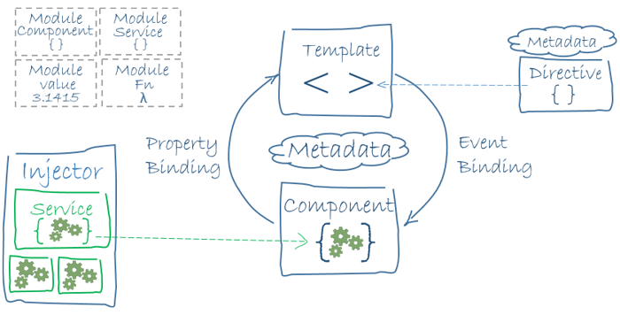
Building block of Angular
Modules
Components
Templates,
Metadata
directives, & data binding
Services & dependency injection
Routing

Slide 23
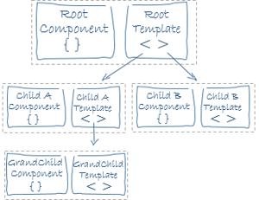
Templates and Views
templateUrl
template
styles
styleUrls

Slide 24
Chapter -5 Data binding
Video Contains:-
What is Data binding
Types of Data binding
How to use in Code

Slide 25
Chapter -5 Data binding
Video Contains:-
What is Data binding
Types of Data binding
How to use in Code

Slide 26
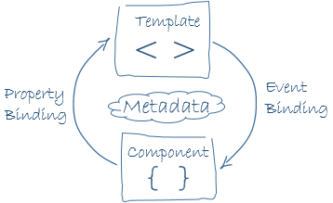
What is Databinding???
Data binding is the core concept of Angular 9 and used to define the communication between a component and the DOM

Slide 27
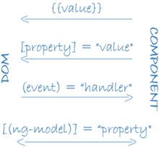
Types of Data Binding
String interpolation – {{}}
<li>Name: {{ user.name }}</li>
Property Binding – []
<input type="email" [value]="user.email">
Event Binding – ()
<button (click)=“checkMail()"></button>
Two-way Data Binding – [()]
[(ngModel)] = "[property of your component]"

Slide 28
Chapter 6 - Directives
Video Contains:-
What is Directives
Types of Directives
How to use in Code

Slide 29
Chapter 6 - Directives
Video Contains:-
What is Directives
Types of Directives
How to use in Code

Slide 30

Directives
used to manipulate the DOM.
you can change the appearance, behavior or a layout of a DOM element. It also helps you to extend HTML.
Component Directives
Component directives are used in main class. They contain the detail of how the component should be processed, instantiated and used at runtime.
Structural Directives
*ngIf Directive, *ngSwitch Directive, *ngFor Directive
Attribute Directives
ngClass Directive, ngStyle Directive
Custom Directives

Slide 31
Chapter 7 – Components & Life Cycle hooks
Video Contains:-
Components
Component Lifecycle

Slide 32
Chapter 7 – Components & Life Cycle hooks
Video Contains:-
Components
Component Lifecycle

